Slide 1
Contextual Inquiry and Consulting Foundations
Good morning!
Sit wherever you like for now.
Class will start at 9am or so.
Welcome to SI 501!
Kentaro Toyama
Pronouns: he/him/his
Lecture 001: Mondays 9-11am Eastern Time
Zoom: https://umich.zoom.us/j/7412801664 Passcode: si501

Slide 2
Contextual Inquiry and Consulting Foundations
Welcome to SI 501!
Kentaro Toyama
Pronouns: he/him/his
Lecture 001: Mondays 9-11am Eastern Time
Zoom: https://umich.zoom.us/j/7412801664 Passcode: si501

Slide 3
Contextual Inquiry and Consulting Foundations
Welcome to SI 501!
Please call me by my first name – this will help you get used to U.S. professional culture.
Kentaro Toyama
Pronouns: he/him/his
Lecture 001: Mondays 9-11am Eastern Time
Zoom: https://umich.zoom.us/j/7412801664 Passcode: si501

Slide 4
Contextual Inquiry and Consulting Foundations
Welcome to SI 501!
Kentaro Toyama
Pronouns: he/him/his
Lecture 001: Mondays 9-11am Eastern Time
Zoom: https://umich.zoom.us/j/7412801664 Passcode: si501

Slide 5
Contextual Inquiry and Consulting Foundations
Welcome to SI 501!
Kentaro Toyama
Pronouns: he/him/his
Lecture 001: Mondays 9-11am Eastern Time
Zoom: https://umich.zoom.us/j/7412801664 Passcode: si501

Slide 6
Contextual Inquiry and Consulting Foundations
Welcome to SI 501!
Kentaro Toyama
Pronouns: he/him/his
Lecture 001: Mondays 9-11am Eastern Time
Zoom: https://umich.zoom.us/j/7412801664 Passcode: si501

Slide 7
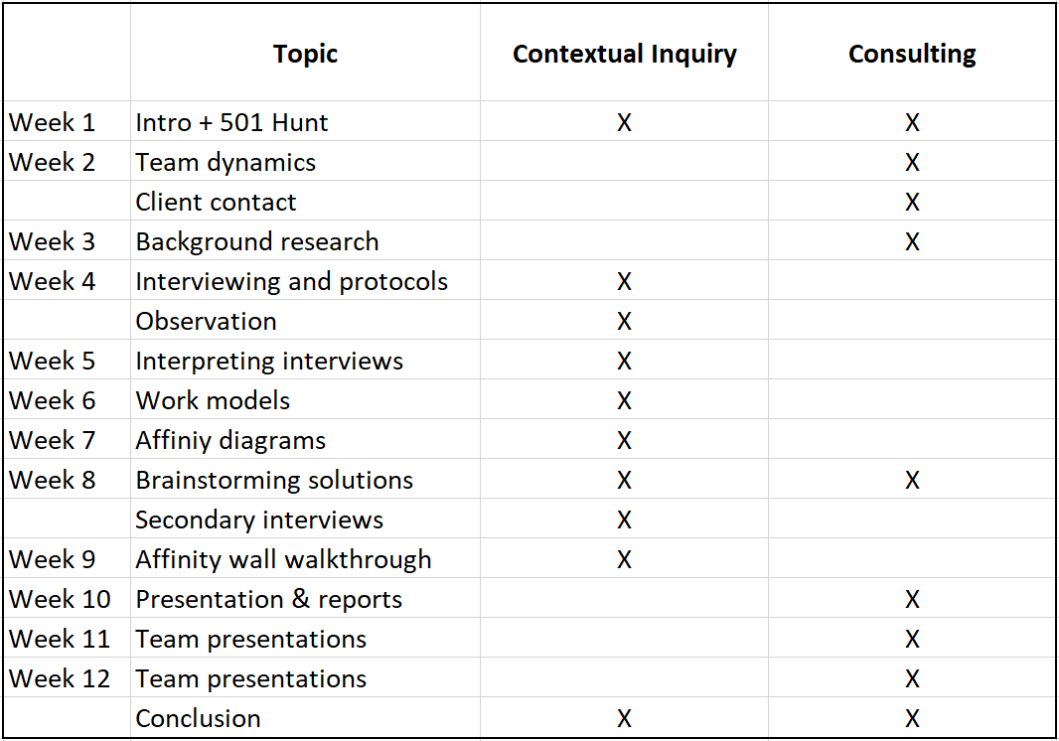
Course Overview

Slide 8
Team-Based Real-World Projects
Throughout this course, you will…
Work with a team of 4-5 students;
Work with a client or a problem of your team’s choice that has an existing information, work flow, or service-delivery challenge;
Perform contextual inquiry and offer recommendations for the client (real or hypothetical) to address their challenge.
You will not…
Implement recommendations or solutions for the client.

Slide 9
Course Overview
Reading quizzes individual 10%
Various pass/fail activities team 5%
Background research report individual 10%
Interview protocol team 10%
Annotated interview/observation notes individual 10%
Affinity wall walkthrough team 10%
Final presentation team 10%
Final report team 15%
Class participation individual 20%
The last day of class is Dec. 6, and the final assignment is due that week. Everyone is expected to be present in class (virtually) on Dec. 6.
No final exam. However, you will have a final presentation with your client that needs to be scheduled sometime in December.

Slide 10
Instructors
Instructor
Kentaro Toyama
Graduate Student Instructors (GSIs)
Damon Carucci (003 and 013)
Annie Flynn (015)
Halima Haque (005 and 007)
Sonny Kim (009 and 011)
Office hours, email addresses, Zoom links for Discussion section, are all in the syllabus. The syllabus is in the Canvas for your Discussion section.
Contact your GSI or the instructors if you have any questions at any time.
If you’re ever not sure whom to contact, email si501staff001@umich.edu.

Slide 11
Class Rules [1 of 3]
Both Lecture and Discussion start on the hour. They will end 10 minutes before the hour.
You’re strongly encouraged to be present synchronously for Lecture.
You must be present synchronously for Discussion section.
For everything that happens on Zoom in this course, we encourage you to leave your video on. Especially so for any work with your team.
For everything that happens on Zoom in this course, leave your audio muted except when you’re speaking.
Do your best to be a good team member!

Slide 12
Class Rules [2 of 3]
If you are in class in person, please leave your laptops closed and your smartphone off (or face down) unless we need it for a class activity.
When indoors, please wear a mask. (This is current U-M policy.)
AVOID PLAGIARISM! If you ever cut-and-paste or paraphrase someone else, quote and cite appropriately. See material from the Academic Integrity session at orientation and the “Tips on Avoiding Plagiarism” document in Canvas.

Slide 13
Class Rules [3 of 3]
Late assignments lose 5% for every day of lateness including weekends. If you have a legitimate excuse, email your GSI and professor as soon as you know, before the due date whenever possible.
Let your GSI or professor know if you need accommodations of any kind for any legitimate issue. We will do what we can to accommodate all reasonable requests.
Do not hesitate to contact the professor or GSIs if you have any questions, problems, or comments about the class! The sooner we know, the more likely we can respond appropriately.

Slide 14
Questions?

Slide 15
Weekly Tip #1 for MSI/MHI students
It is not too early to start thinking about applying for internships. Consider doing the following…
Ask 2nd-year students about the process of applying for internships. Ask people who were in the same program as you and share professional interests. This is probably the most helpful thing you can do – they have direct experience.
Start writing or revising your resume.
Read articles online for guidelines – try to find articles that are specific to the jobs you are interested in.
Go to the Career Development Office (CDO) staff for individual help.
Even though you may not be applying right away to internships, reviewing your resume early will also help you identify gaps in your resume that you can work on during the semester.
For most of you, having worked on completed projects helps for your resume, portfolio (for HCI/UX focus), and in internship and job interviews. Some of this will happen in courses, but you can do more in internships, part-time jobs, co-curricular activities, and side projects. Look for opportunities that are relevant to your job interests.

Slide 16
For next time (Sept. 13)…
Read the following (all on Canvas)…
SI501 Overview: Contextual Inquiry and Consulting Foundations
Tuckman (1965) [only the pages indicated in the syllabus]
Barczak et al. (2010)
Holtzblatt et al., Chap. 3
Take the graded quiz about the readings (Quiz 1) on Canvas before the Sept. 13 Lecture.
Be prepared to discuss the readings in Lecture. The instructor may cold-call you!
You will be asked to complete a team feedback form before the next class. Please complete it before the announced deadline. (What you write in it will not affect your or anyone else’s grade, but completion of the form will affect your final grade.)
Many teams meet separately to get to know each other, without a coursework agenda. Between now and next class is a good time!

Slide 17
Today’s Activity: 501 Hunt! [1 of 2]
Complete a series of tasks and solve a series of puzzles.
This activity has no impact on your grade.
Time allotted: Now until 11:59pm ET on Wed, Sept. 1. You will have the remainder of Lecture today and most of Discussion section this week to work on it. Your team can also choose to work outside of class on the Hunt. You should not need more than 6 hours to complete everything.
Within each Discussion section, teams will be scored according to performance. Teams will then get their choice of client in the order of their performance. The highest-scoring team chooses first within each section.
This activity has no impact on your grade.
Be smart about how you solve the tasks and puzzles. We will dispense hints through Canvas announcements (and to your email). If you get stuck, ask a GSI or instructor for help!

Slide 18
Today’s Activity: 501 Hunt! [2 of 2]
In a few mores slides (not yet!), you will be prompted to gather and meet your SI 501 team members.
Some teams will experience changes in members today and over the next few weeks – please be open to accommodating new members!
Once you’ve found your team, you can start on the 501 Hunt right away.
Your team can choose to work outside of the Lecture room. If you do this, please write your team code and where you will be working on the blackboard, so we can find you. You do not need to return here at the end of class. But, make sure to go to your Discussion section!
Make sure to include any team members who are virtual!
If you can’t find your team, or don’t seem to have been assigned a team, or have any questions at all, please come speak with a GSI or instructor. If you are virtual and can’t seem to get our attention, email si501staff001@umich.edu.
Please be a bit patient – this time may be a bit chaotic. But, everyone will end up in a team, don’t worry!

Slide 19
Team Assignments
Make sure that the NUMBER of your team corresponds to your discussion section number.
003 – M 3-4pm, 1255 NQ GSI: Damon
005 – M 4-5pm, 2011 MLB GSI: Halima
007 – M 11am-noon, 506 BMT GSI: Halima
009 – M 7-8pm, 2011 MLB GSI: Sonny
011 – T 3-4pm, 1448 MH GSI: Sonny
013 – T 3-4pm, 2185 NQ GSI: Damon
015 – 7-8pm, 1255 NQ GSI: Robert
All team members should be in the same Discussion section. If you changed your Lecture and/or Discussion section recently, or if you plan to change it, and your team assignment is not with your new section, please find the two GSIs affected (see above) and let them know immediately.

Slide 20
Questions?

Slide 21
Ready?

Slide 22
Remember: This activity has no impact on your grade!

Slide 23
Go to https://j.mp/si501f21teams to find your team code. It will have the following format: K-016M Then, go to the sheet along the walls to find your teammates. In some cases, one or two of your teammates may be virtual, so you will need to connect to the Zoom for this class https://umich.zoom.us/j/7412801664 We’ll put you in a Zoom breakout room with your teammate(s).

Slide 24
Challenge 1
HINTS
Use Google!
Document your team’s process during the 501 Hunt in a team report. At the end of the 501 Hunt, your team will submit this report; your team will be scored solely based on this one report, so make it a good one! The report should provide a good sense for how your team went about solving the 501 Hunt. It should be a digital file that can be submitted on Canvas as a team. (You must submit a file. Avoid Google Docs, Evernote, or any other online document that can be modified after class ends.)
You will receive points for…
Content relevance.
Thoroughness of the documentation – think “who, what, when, where, why, and how.”
Neatness, attractiveness, and professionalism. Good formatting matters!
Clarity.
Creativity and any extra effort to make the report stand out.
For Challenge 2…
http://[the full name of the male lead instructor of this course with no spaces (note: there are two SI 501 lead instructors this semester)].[the first three letters of the musical instrument that Bach’s Toccata and Fugue in D minor is typically performed on]/[number representing the philosophy and theory of science, according to the library classification system developed by Melvil Dewey].[lower-case letters that look like an addition sign, a multiplication sign, an addition sign]
Submit the final document by end of day, Sept. 1 (Wed) on Canvas.

Slide 25
Discussion Section

Slide 26
For next time (Sept. 13)…
Read the following (all on Canvas)…
SI501 Overview: Contextual Inquiry and Consulting Foundations
Tuckman (1965) [only the pages indicated in the syllabus]
Barczak et al. (2010)
Holtzblatt et al., Chap. 3
Take the graded quiz about the readings (Quiz 1) on Canvas before the Sept. 13 Lecture.
Be prepared to discuss the readings in Lecture. The instructor may cold-call you!
You will be asked to complete a team feedback form before the next class. Please complete it before the announced deadline. (What you write in it will not affect your or anyone else’s grade, but completion of the form will affect your final grade.)
Many teams meet separately to get to know each other, without a coursework agenda. Between now and next class is a good time!

Slide 27
Continue with the 501 Hunt!
Your final 501 Hunt document should be submitted on Canvas as an Assignment.
Deadline: 11:59pm ET on Wed, Sept. 1.
You can work somewhere else (not in the classroom) as a team, but if so, please indicate where you will be on the whiteboard. Include your team code and location.
If you get stuck, please ask me for help!
Questions?

Slide 28
Challenge 1
HINTS
Use Google!
Document your team’s process during the 501 Hunt in a team report. At the end of the 501 Hunt, your team will submit this report; your team will be scored solely based on this one report, so make it a good one! The report should provide a good sense for how your team went about solving the 501 Hunt. It should be a digital file that can be submitted on Canvas as a team. (You must submit a file. Avoid Google Docs, Evernote, or any other online document that can be modified after class ends.)
You will receive points for…
Content relevance.
Thoroughness of the documentation – think “who, what, when, where, why, and how.”
Neatness, attractiveness, and professionalism. Good formatting matters!
Clarity.
Creativity and any extra effort to make the report stand out.
For Challenge 2…
http://[the full name of the male lead instructor of this course with no spaces (note: there are two SI 501 lead instructors this semester)].[the first three letters of the musical instrument that Bach’s Toccata and Fugue in D minor is typically performed on]/[number representing the philosophy and theory of science, according to the library classification system developed by Melvil Dewey].[lower-case letters that look like an addition sign, a multiplication sign, an addition sign]
Submit the final document by end of day, Sept. 1 (Wed) on Canvas.

